Slide 1
Introduction to MCBK
Research Team
North Carolina Central University, Durham, NC, USA
2023 update

Slide 2
Open Education Resources (OER)
Introduction – Friedman quote
What is MCBK (Definition)
Manifesto
Development Cycle and gap
IMLS Grant 2021-2023
Summary: Outline for OER Collection
NCCU Research Team

Slide 3
From Charles Friedman: “Dynamic Knowledge”)
“Think about knowledge as the result of an analytical and/or deliberative process that holds significance for an identified community.” (Charles Friedman, University of Michigan Medical School, LHS dept. chair; ICKM 2020 keynote)
The Learning Health Systems journal welcomes submissions for computable knowledge publications that make models representing biomedical knowledge available as peer-reviewed software. Such a publication consists of two components: (i) One or more computable biomedical knowledge artifacts (CBKs), which are software artifacts, and (ii) a written human-readable manuscript describing the CBKs and their underlying models.
To propose a submission, send an email to Kathleen Young, the Journal’s Editorial Assistant, at kayoung@med.umich.edu . Questions? Ask Charles (Chuck) Friedman, cpfried@umich.edu

Slide 4
MCBK Definition
Mobilizing Computable Biomedical Knowledge (MCBK) is part of Learning Health Systems developments and recommendations
Goal is to decrease time from performance data collection to knowledge and reduce “the gap” to implementation of medical devices, system algorithms, programs, and new patient procedures
Sharing medical developments and research through open access will allow machine readable information to be validated and enhance human documentation
Metadata models for sharing knowledge are recommended following guidelines for FAIR (findable, accessible, interoperable and reusable) storage
Librarians and knowledge managers working with biomedical and healthcare researchers and developers can support future LHS efforts using MCBK

Slide 5
MCBK Manifesto (October, 2018)
Preamble
Knowledge has the potential to improve health care, the health of individuals, and the health of populations. Every decision affecting health should be informed by the best available knowledge. For moral and ethical reasons, it is imperative that each and every member of society has access to what is known at the time they are making health-related choices and decisions.
It is no longer sufficient to represent knowledge in the form of printed words and static pictures. The increasingly rapid rate of scientific discovery needs knowledge representations that are more agile and amenable to scalability and mass action. This in turn can enable the continuous cycles of discovery and improvement envisioned as Learning Health Systems…
Activities: Sustain ecosystem through public and private partnerships; establish CBK technical system enabling open standards and trust; and for use and users of CBK ensure safe and effective system that values creators.
See https://mobilizecbk.med.umich.edu/about/manifesto

Slide 6
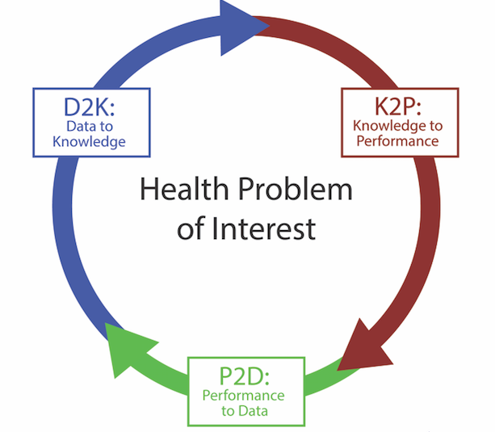
LHS: Continuous Cycles of Study and Change (reducing gap from 17 years to 17 months)

Slide 7
Closing Cycle Gap
It is estimated that using traditional publications it takes 17 years for D2K (Data to Knowledge) to become implemented as K2P (Knowledge to Performance). Then the cycle can start again as new performance to data (P2D).
With MCBCK and the open access sharing of computable knowledge, the gap can be reduced to months not years.
Researchers with data analytics, programmers with code, Artificial Intelligence and Machine Learning algorithms for decision-making systems, and systematic reviewers of literature can participate in a community of practice (CoP) for MCBK success and healthcare improvements.

Slide 8
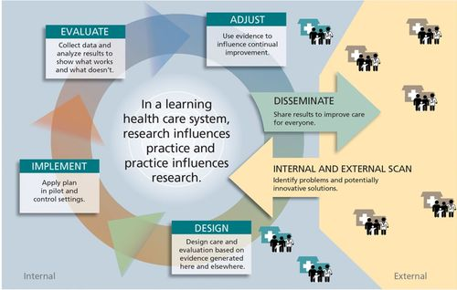

Slide 9
Modules in OER Collection
Publishing in open access journal for LHS
Collaborating as researchers/practitoners and librarians/knowledge managers
Special topics:
Bias and algorithmic justice
Metadata Models and Infrastructure
MCBK chapters, conferences, workgroups
Publication Access Through Tiered Interaction & Exploration (PATTIE).
National Library of Medicine (NLM)

Slide 10
Exercises, Slides, Webinars, and Videos
For training, see “Read First” document
Videos and slides from Pilot Training
Systematic Project Reviewers
Librarian as reviewers and authors
Standards from Academy of Medicine; PICO; and PRISMA reviews
Technical Infrastructure for CBK Repositories
MCBK Metadata and Research Networks
EXAMPLE: Observational Health Data Sciences & Informatics (OHDSI)
CBK Tools and Resources: National Library of Medicine (NLM)
Planning Community of Practice (CoP) and KM framework using SECI
Continued MCBK education: see Learning Health Sciences | Michigan Medicine | University of Michigan (umich.edu) including webinars with LHS Collaboratory (LHSCollaboratory-info@umich.edu )

Slide 11
MCBK Workgroups
Find out about MCBK webinars, workgroups and events: https://mobilizecbk.med.umich.edu/about
Sustainability and Inclusion → HEAL
Trust and Policy
Technical Standards and Infrastructure
CBK-MM (Metadata Model)

Slide 12
Open Education Resources: Storing and Accessing Computable Biomedical Knowledge (CBK)
Dr. Deborah Swain, PhD and Nijee Brown, MIS
ALISE Conference
North Carolina Central University
October 25, 2022
School of Library and Information
Sciences
Abstract
A Pilot Training was held in Dec and Jan 2021-2022. Pre- and post-assessments of the training attended by medical providers, health library directors, and LIS educators provided quantitative and qualitative data to design the OER. Applying “open pedagogy,” we will support copyright laws but create and share practices that sidestep proprietary entanglements as librarians in Arizona have researched (Casey & Daly, 2021). We are developing an “open textbook” with learning modules about how to publish in open access, avoid bias, review systematically, redefine librarian’s role, and use NLM tools.
Discussion
Can library scientists move forward as
gatekeepers, creators, and consumers of
computable biomedical knowledge or CBK
(Williams, et al., 2020)? Our work-in-progress
research says “Yes!” We are developing Open
Education Resources (OER) to support the
transformation.
This research builds on library skills to help
information scientists and knowledge managers
promote CBK.
Reviewing feedback from a pilot class for LIS
professionals, we are developing online,
sustainable open educational resource (OER)
materials for global users. Through a
community of practice (COP), users may help
efficiently deliver biomedical applications for
researchers, LIS professionals, healthcare
providers, and patients.
Our goal grew from Institute of Museum
and Library Services (IMLS) training grant
RE-250159-OLS-21 objectives to put Library
and information professionals up front
designing and maintaining effective medical
repositories while collaborating with authors.
Research Methods and Literature Review
Access to data is essential to establishing
effective Learning Health Systems (LHSs).
The vision is to improve healthcare where
underutilization of appropriate and
overutilization of inappropriate care lead to
rising costs, less safety, and health disparities
(Friedman, et al., 2017).
The “mobilizing CBK” movement from
The University of Michigan’s Medical School
LHS department is providing infrastructure,
metadata, and networks to writing developers
worldwide so access to research knowledge
will support health-related decisions.
Friedman, C., Allee, N., Delaney, B., Flynn, A.,
Silverstein, J., Sullivan, K., and Young, K.
(2017). “The Science of Learning Health
Systems: Foundations for a New Journal,” Learning
Health Systems, 1:e10020. doi: 10.1002/lrh2.10020.
Williams, M., Richesson, R., Bray, B., Greenes, R.,
McIntosh, L., Middleton, B., Perry, G., Platt, J., and Shaffler,
C. (2020). “Summary of Third Annual MCBK Public
Meeting: Mobilzing Computable Biomedical Knowledge –
Accelerating the second knowledge revolution,”
Learning Health Systems, 5:1 (Special Report)
Purpose of the Study
Assessment Data Highlights
References
#4-LHS Open Author Guidelines | #9-Ethics of CARE & FAIR Principles | #14-MCBK Metadata Issues | #17-NLM Strategies for CBK | #19-How to Search for CBK
112% increase in post-assessment | 109% increase in post-assessment | 109% increase in post-assessment | 124% increase | 122% increase
4.35 Mean (1-5) | 4.8 Mean (1-5) | 4.5 Mean (1-5) | 4.15 Mean (1-5) | 4.55 Mean (1-5)
11 (of 20) students could list a guideline | 15 (of 20) could explain principles well | 13 (of 20) could explain issues well | 11 (of 20) could explain strategies well | 12 (of 20) could summarize search well

Slide 13
Acknowledgements
Institute of Museum and Library Services (IMLS) grant agency
Dr. Charles Friedman and Rachel Richesson, Univ. of Michigan Medical School
Dr. Christopher Cunningham, Co-PI/Program Director
20 Pilot Class participants (Dec ‘21-Jan ‘22)
6 Mentors from UNT (new HI program) and MLA

Slide 14
Community of Practice (CoP): IMLS Grant Planning Partners, Mentors, Speaker
Charles Friedman, LHS department chair, Michigan School of Medicine
Rachel Richesson, Michigan School of Medicine
Kathleen Young, Editorial Assistant, LHS journal; Nancy Allee, Director Health Sciences Library
Gerald (Jerry) Perry, Associate Dean for Unversity of Arizona Libraries, and inclusion researcher
Feili Tu-Keefner, health informatics and health sciences librarianship expert at the University of South Carolina
Suliman Hawamdeh, Ana Cleveland, and Jody Philbrick, professors and lecturer at North Texas University
Robin Ann Yurk, MD, healthcare and leadership experience
Shannon Jones, Director of Libraries for the Medical University of South Carolina, MLA Pres.
Javed Mostafa, Professor, UNC-Chapel Hill (PATTIE for Entrepreneurs)
Kim Mayo, retired MLS adjunct professor (NCCU)
Katherine Majewski, NLM librarian and educator
Joshua Richardson, RTI International and Rush Univ Medical Center
Gabe Rios, Indiana University Library Director
Christopher Shaffer, University Librarian, UC-San Francisco

Slide 15
NCCU Research Team
Deborah Swain, IMLS PI/Program Director, dswain@nccu.edu or swainham@msn.com
Danielle Colbert-Lewis, Head of Research and Instructional Services Librarian, dcolbert@nccu.edu
Christopher Cunningham, IMLS co-PI/ Program Director, MLS Program at NCCU chris.cunningham@nccu.edu
Charlotte Cox, Instructional Designer, Extended Studies, ccox33@nccu.edu
Nijee Brown, MLS, former Research Assistant, nijeebrown07@gmail.com
William Tanner, MIS, former Grad Assistant, williamtanner726@gmail.com
Delaina Zeinoun, MIS, early Research Assistant, delaina.e.z.15@gmail.com

